Slide 1



UNIT 8: Fit and healthy
What’s in food?

Slide 2
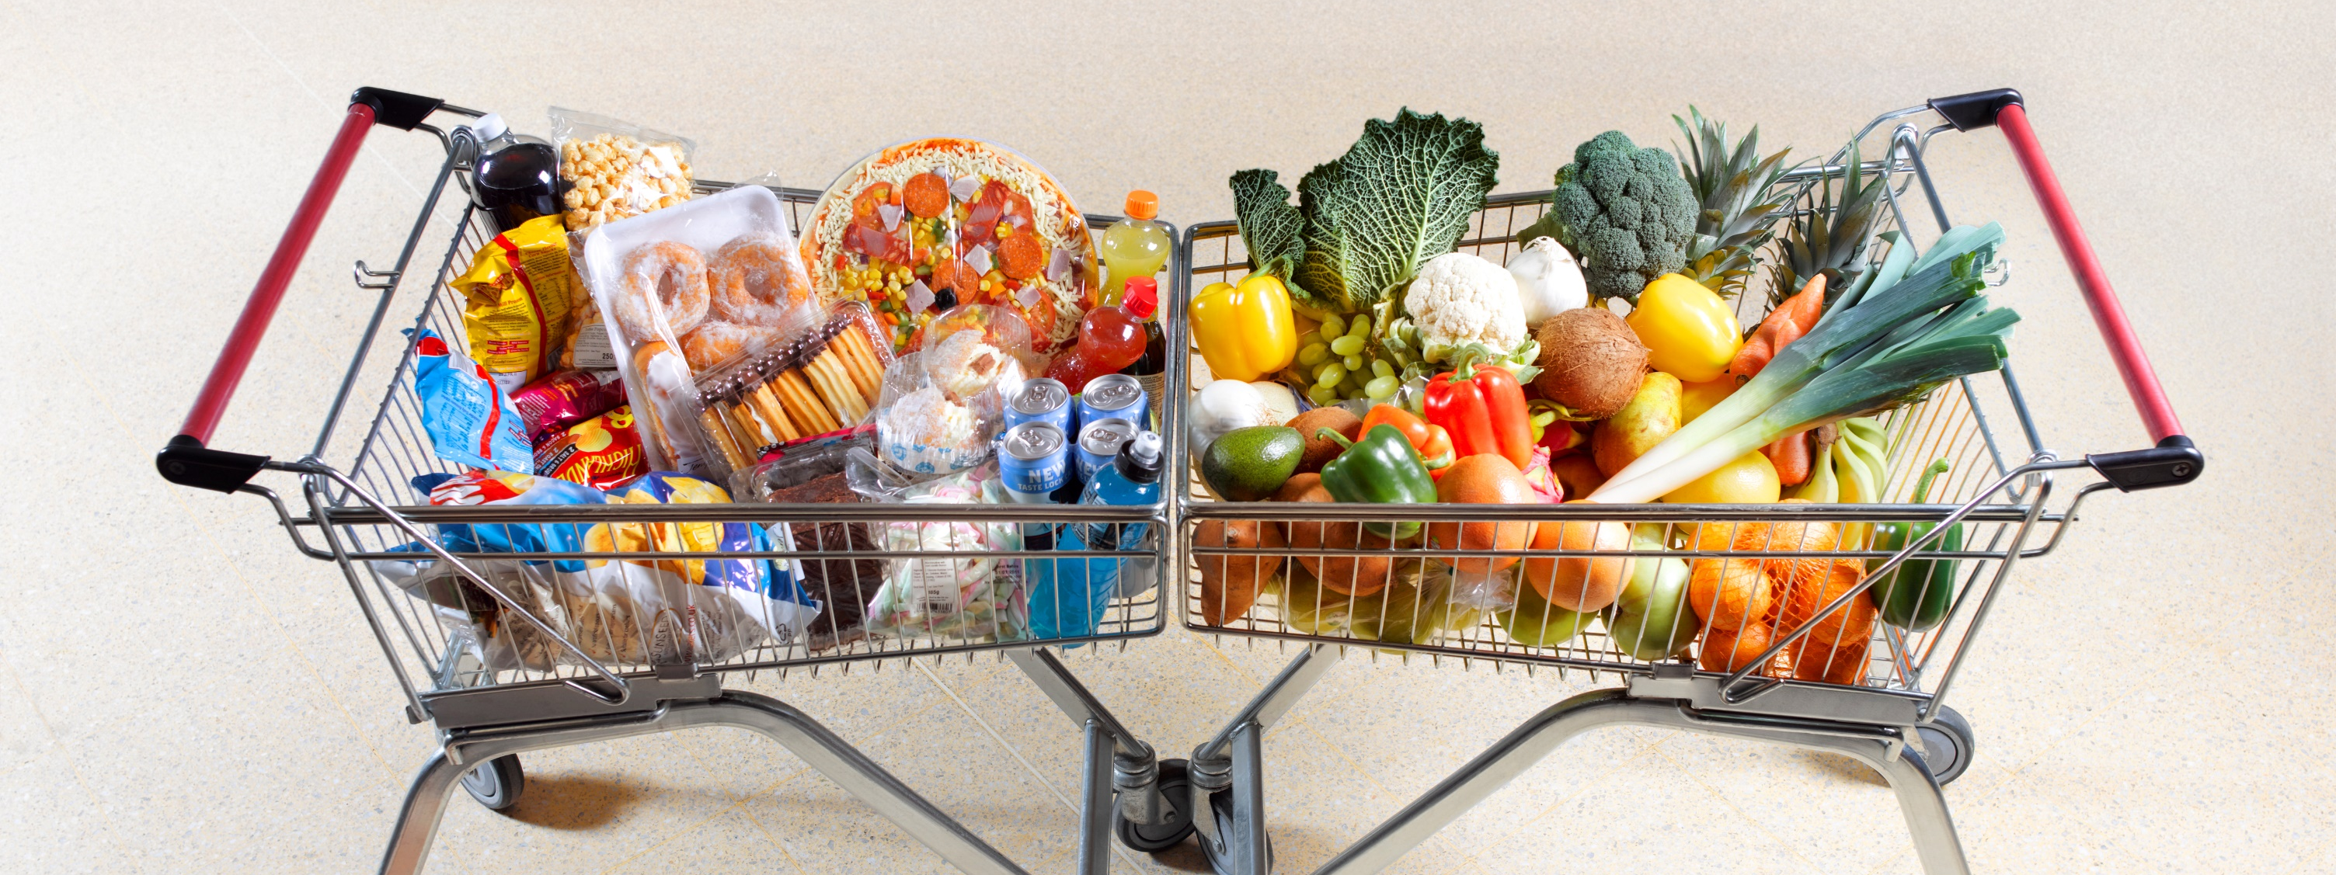
What healthy foods do you know?
What unhealthy foods do you know?
How do you know something is healthy or unhealthy when you go to the supermarket?

Slide 3
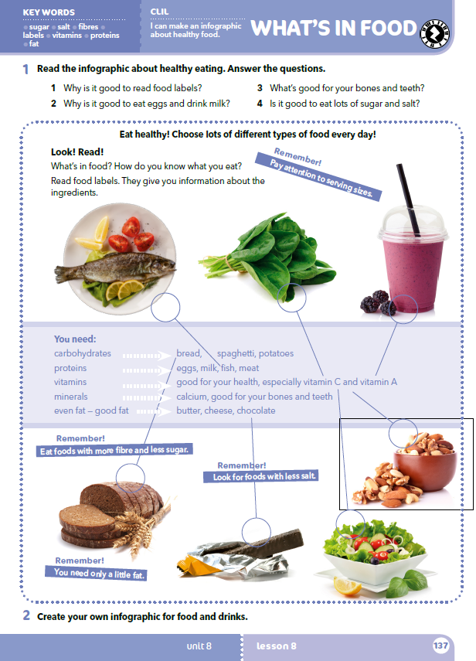
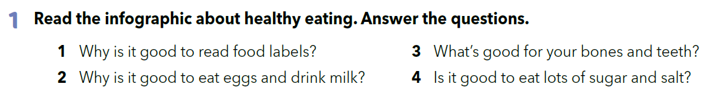
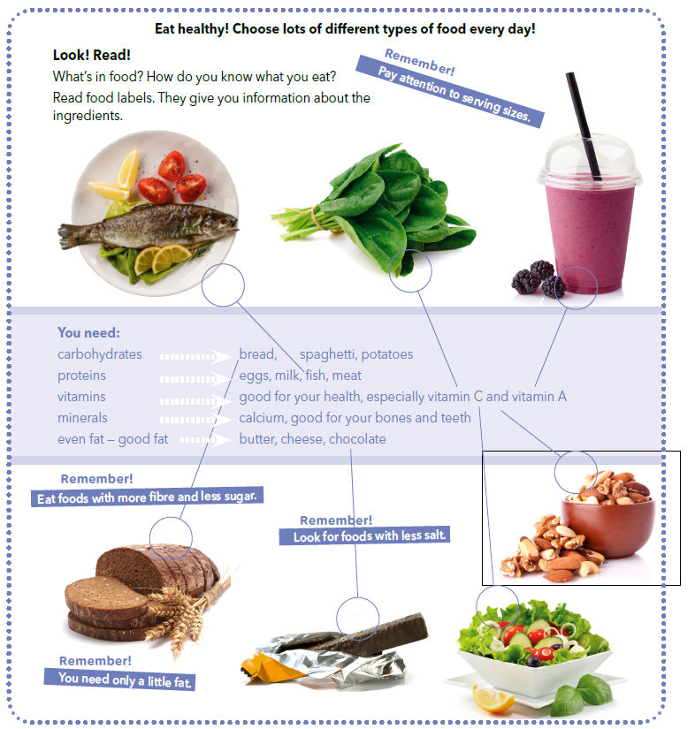

Slide 4
Read the infographic.
Next to each picture write the new piece of information.

Slide 5
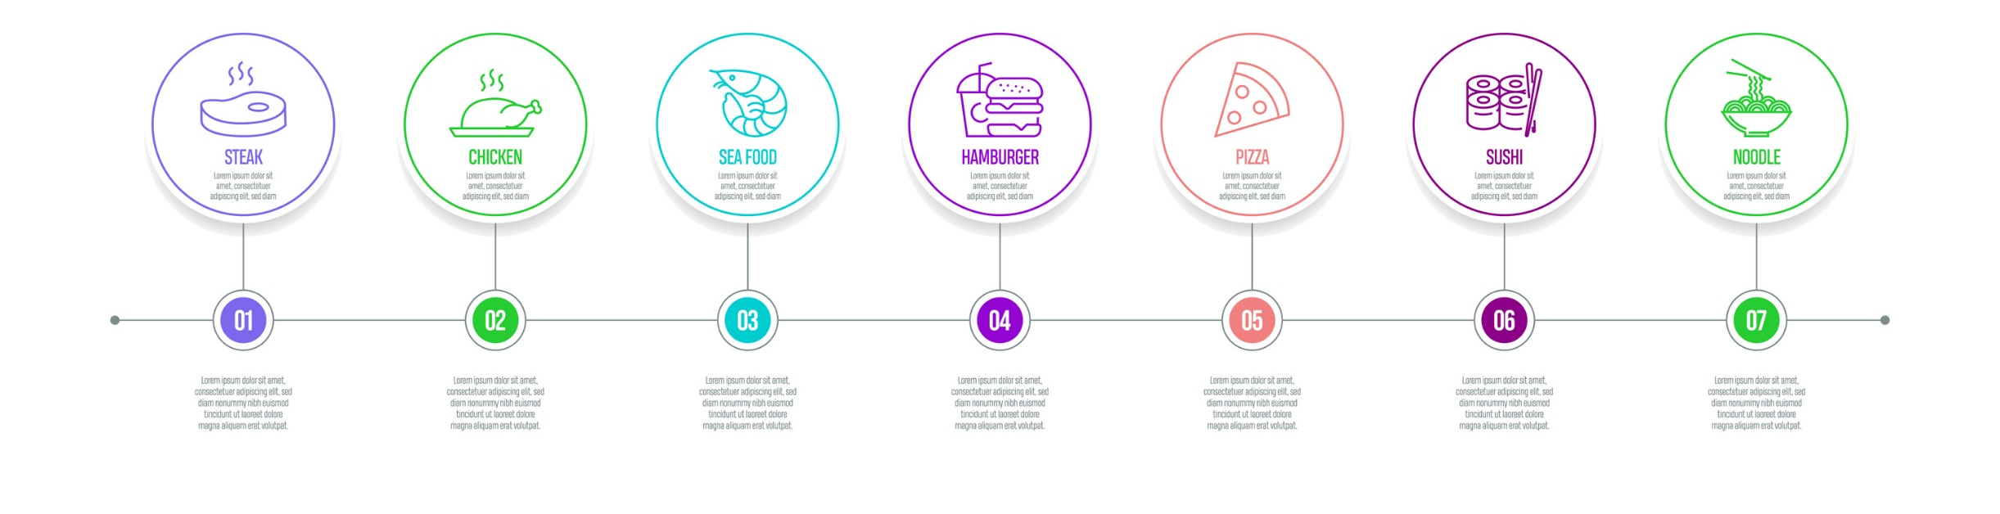
LET’S REVISE!
https://learningapps.org/watch?v=pfvfrcrxk18
https://wordwall.net/play/553/180/900
Pronađi fotografiju svog omiljenog jela i istraži njegove sastojke.
Rezultate svog istraživanja prikaži u obliku mentalne mape ili infografike.

Slide 6
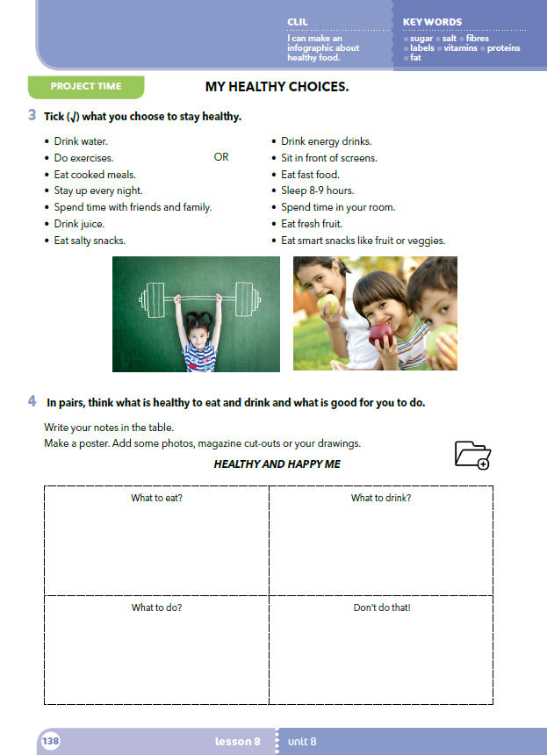
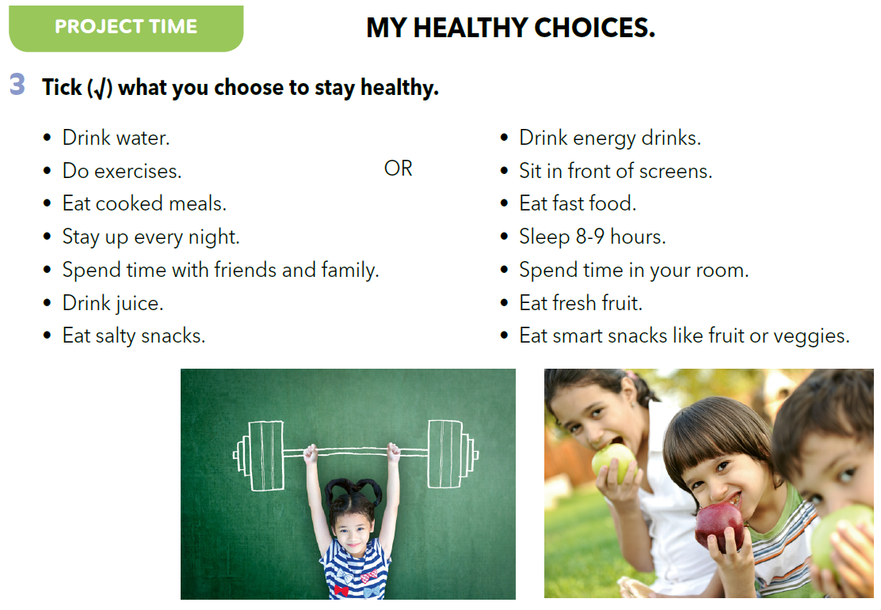

Slide 7
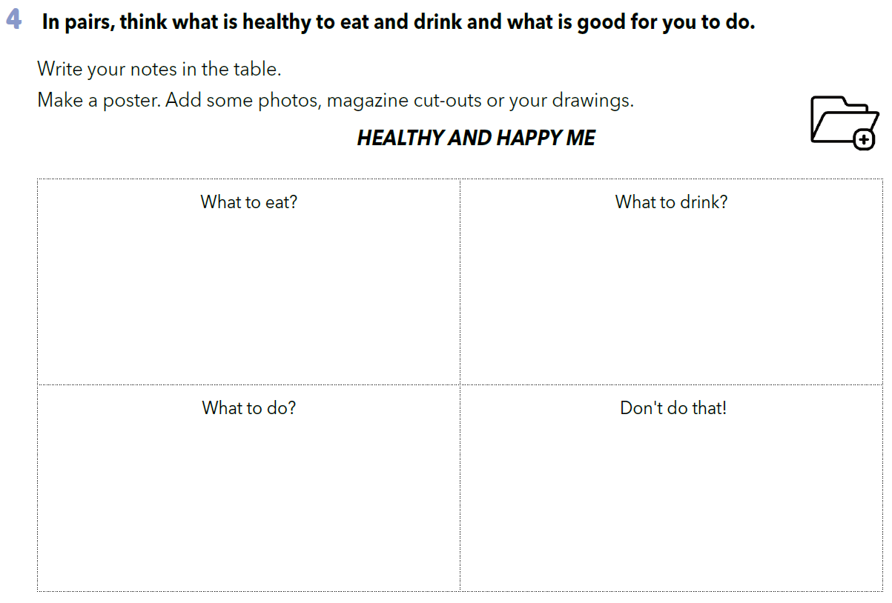
Sort out the habits from task 3 in the correct category. Add some more habits.

Slide 8

LEARN MORE
https://www.e-sfera.hr/dodatni-digitalni-sadrzaji/cdc5f2ad-955e-47c1-9452-40d24d5753a2/
I love food – but not all!

